Slide 1
TASK 2
SCANNING VULNERABILITIES OF A WEB APPLICATION

Slide 2
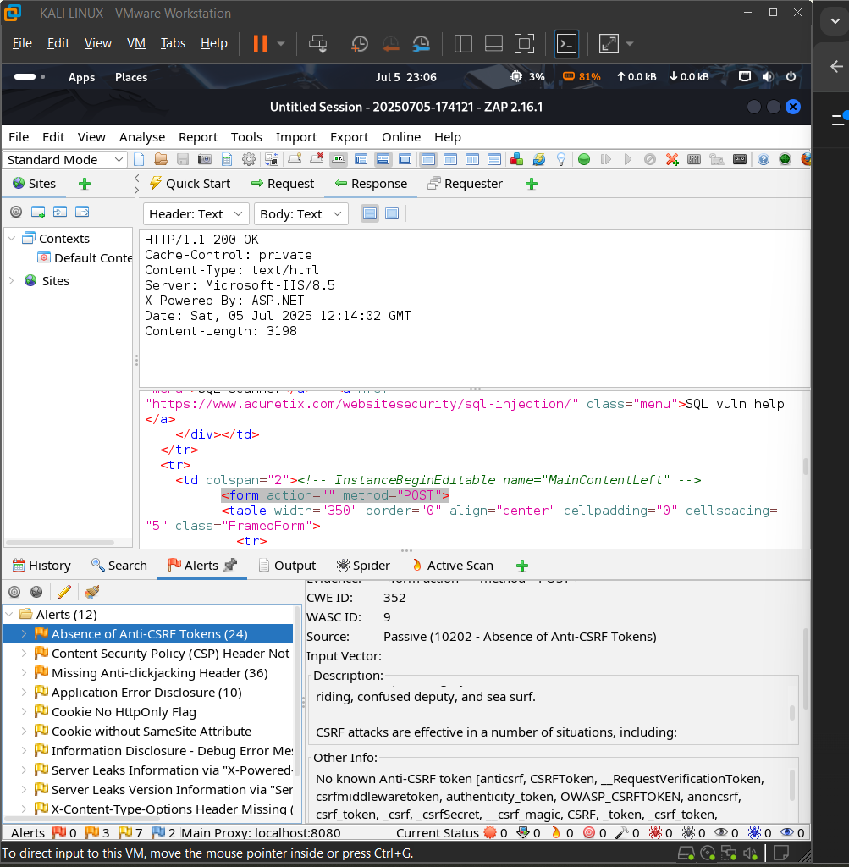
Vulnerability Name - Absence of Anti-CSRF tokens

Slide 3
URL affected : http://testasp.vulnweb.com/Login.asp?RetURL=%2FDefault%2Easp%3F
Risk – Medium
Reason : A form or request endpoint accepts POST/GET requests that do not contain any anti-CSRF token parameter

Slide 4
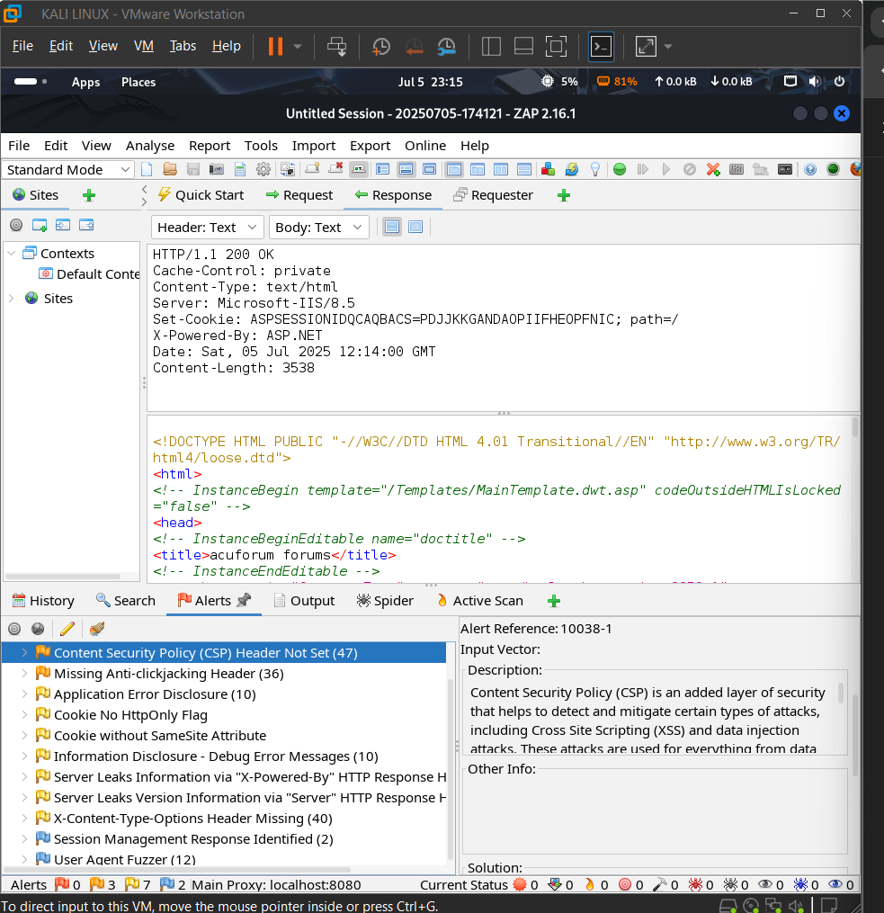
2) Vulnerability name - Content security policy (CSP) Header not set

Slide 5
URL affected - http://testasp.vulnweb.com/
Risk - medium
Reason - The web server does not include the Content-Security-Policy header in its HTTP response. This header helps control which resources (like scripts, styles, images) the browser is allowed to load.
Without it, the application is more vulnerable to attacks like Cross-Site Scripting (XSS) and data injection.

Slide 6
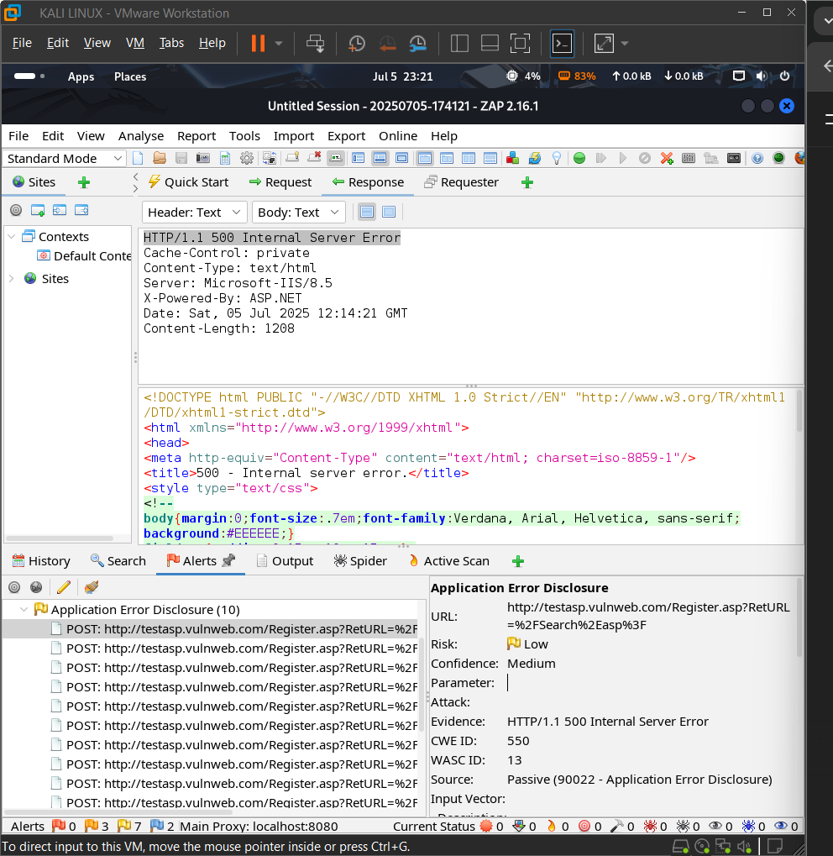
3) Vulnerability name - Application error disclosure

Slide 7
Risk - low
URL affected - http://testasp.vulnweb.com/Register.asp?RetURL=%2FSearch%2Easp%3F
Reason - The website shows detailed error messages in the browser. These messages may reveal sensitive info like file paths or server details. Attackers can use this info to plan further attacks.

Slide 8
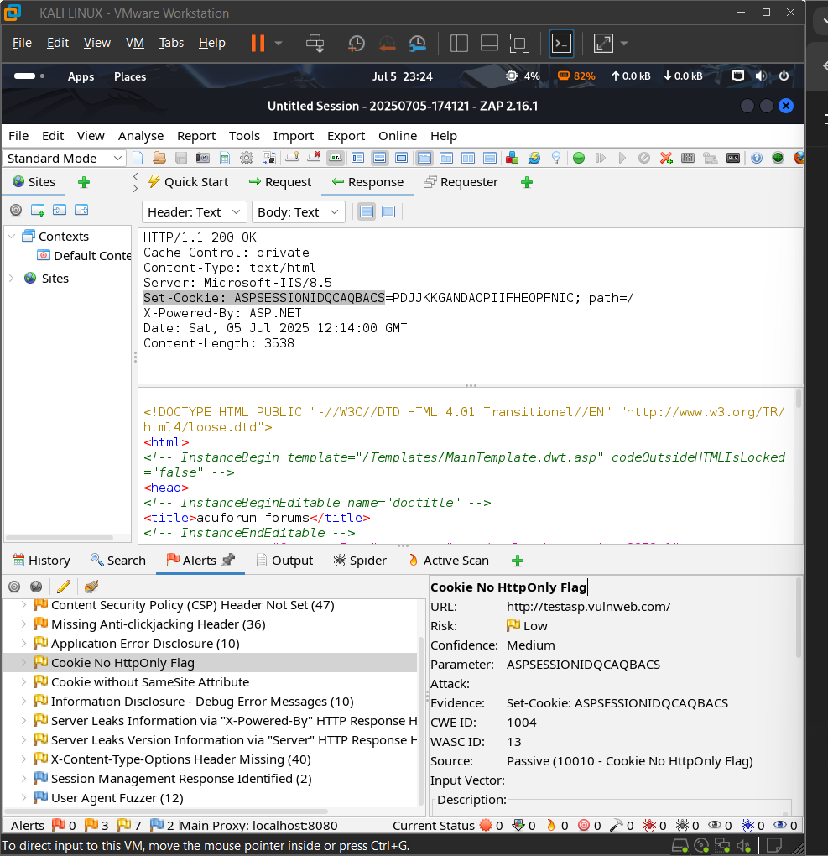
4) Vulnerability name - Cookie No http only flag

Slide 9
Risk - Low
URL Affected - http://testasp.vulnweb.com/
Reason –
The application sets cookies without the HttpOnly attribute. This allows JavaScript to access the cookies. An attacker could steal them using XSS attacks

Slide 10
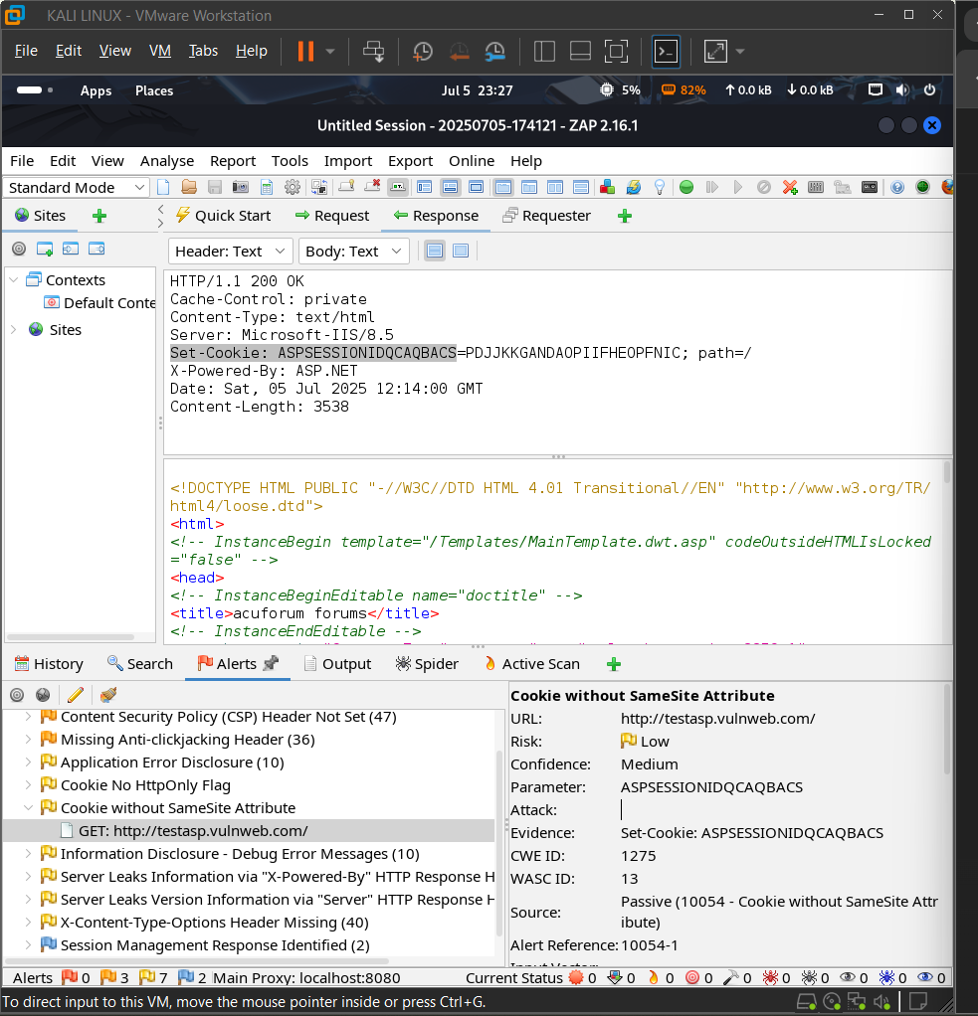
5) Vulnerability name - Cookie without SameSite Attribute

Slide 11
Risk – Low
Url affected - http://testasp.vulnweb.com/
Reason –
The server sets cookies without the SameSite flag. This makes them vulnerable to being sent with cross-site requests. It can lead to CSRF (Cross-Site Request Forgery) attacks

Slide 12
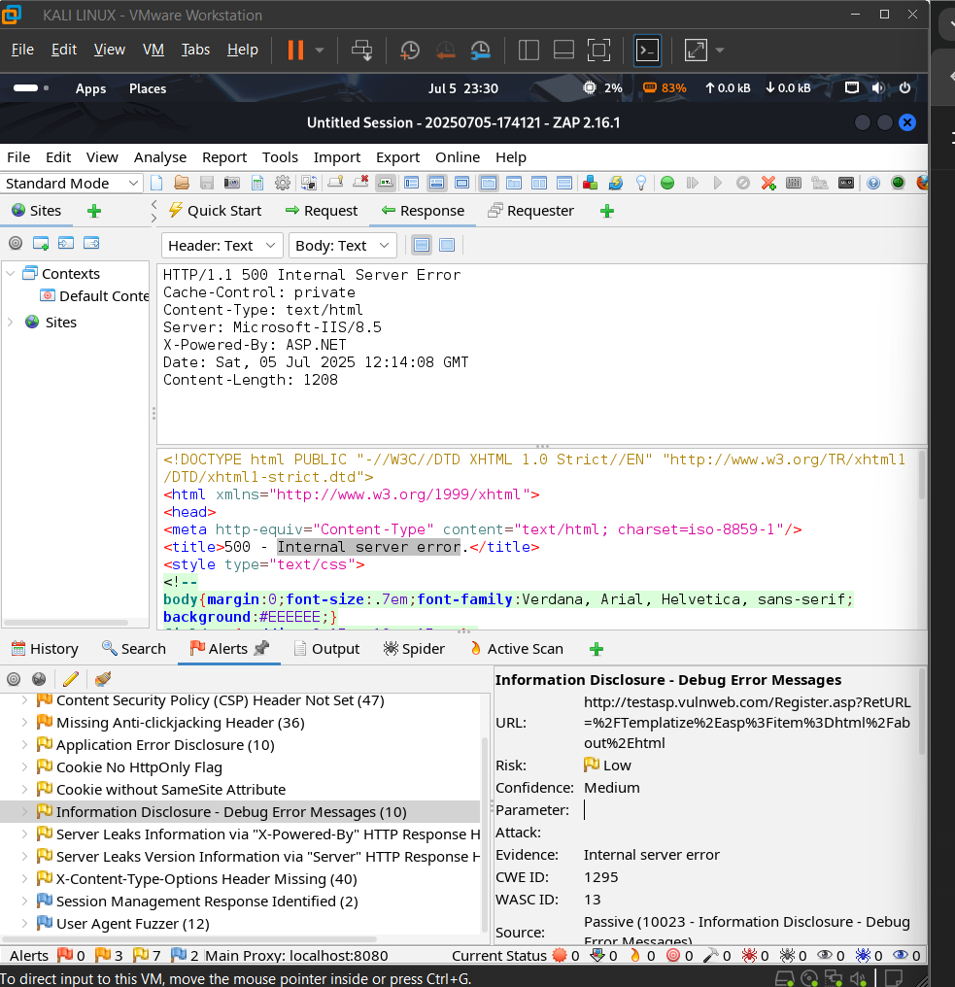
6)Vulnerability name - Information Disclosure - debug error message

Slide 13
Risk – Low
URL Affected - http://testasp.vulnweb.com/Register.asp?RetURL=%2FTemplatize%2Easp%3Fitem%3Dhtml%2Fabout%2Ehtml
Reason –
The application displays debug or error messages in the browser. These messages may reveal server paths, technologies, or code info. Attackers can use this to find weaknesses in the system.

Slide 14
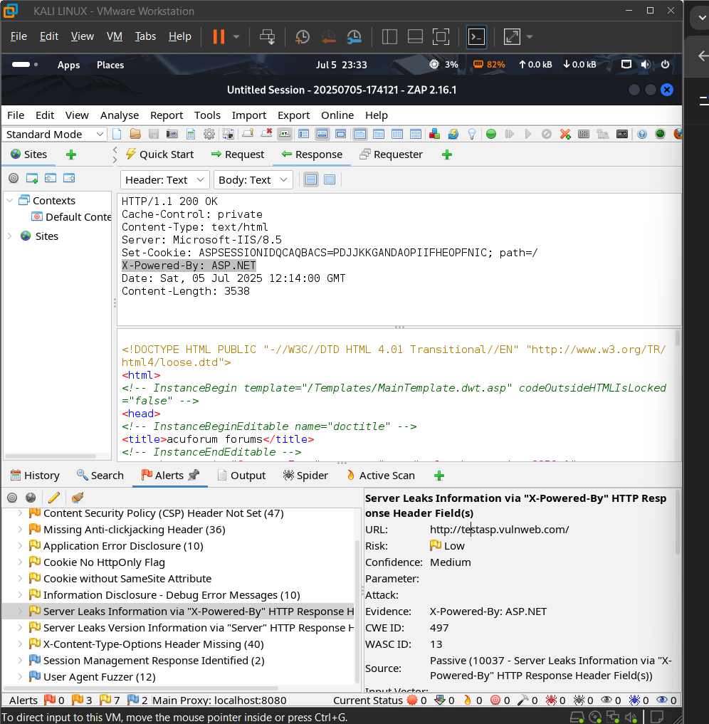
7)Vulnerability name - Server Leaks Information via "X-Powered-By" HTTP Response Header Field(s)

Slide 15
Risk – Low
URL affected - http://testasp.vulnweb.com/
Reason –
The server includes the X-Powered-By header in responses. It reveals backend technology (e.g., PHP, ASP.NET) to users. Attackers can use this info to target known vulnerabilities.

Slide 16
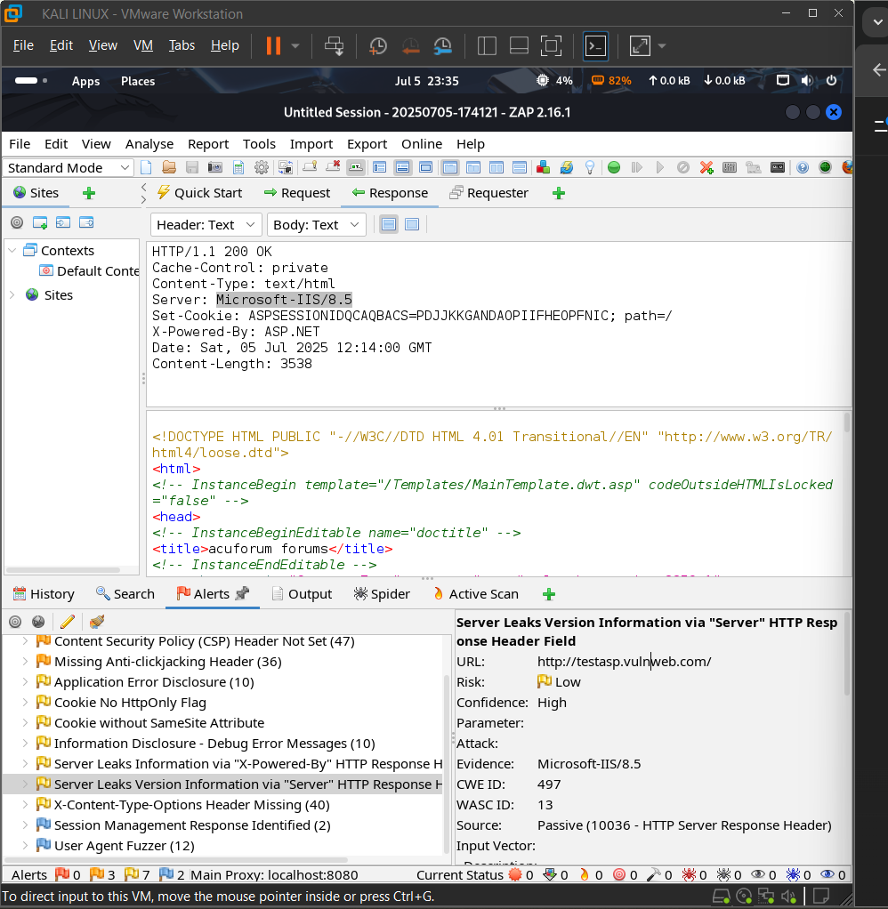
8) Vulnerability name - Server Leaks Version Information via "Server" HTTP Response Header Field

Slide 17
Risk – low
URL affected - http://testasp.vulnweb.com/
Reason - The Server header reveals the web server type and version. This helps attackers identify software-specific vulnerabilities. Hiding version info reduces the risk of targeted attacks.

Slide 18
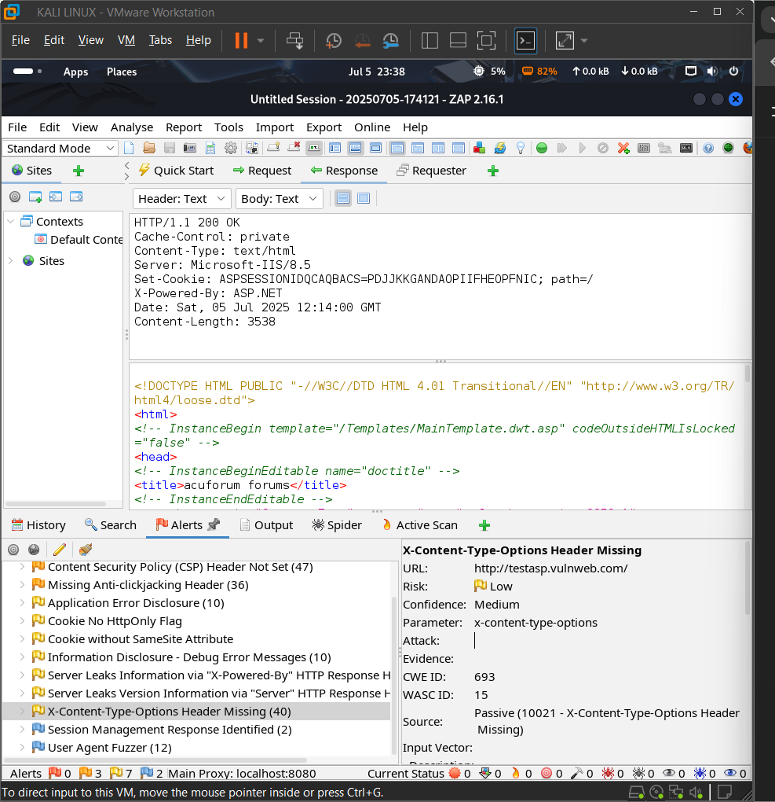
9) Vulnerability Name - X-Content-Type-Options Header Missing

Slide 19
Risk - Low
URL affected - http://testasp.vulnweb.com/
Reason –
The server response is missing the X-Content-Type-Options: nosniff header. Without it, browsers may try to guess file types, which is risky. This can lead to MIME-sniffing attacks like XSS.

